Slide 1


Directing the cursor movements
through eye
A mini project
A mini project

Slide 2
INTERNAL GUIDE
PROJECT BY
MISS NIKHAT FATIMA
MOTHESHEEN KHATOON [18L51A0578]
NUHA GULAM [18L51A0592]
ONAIZA FATIMA [18L51A0593]

Slide 3

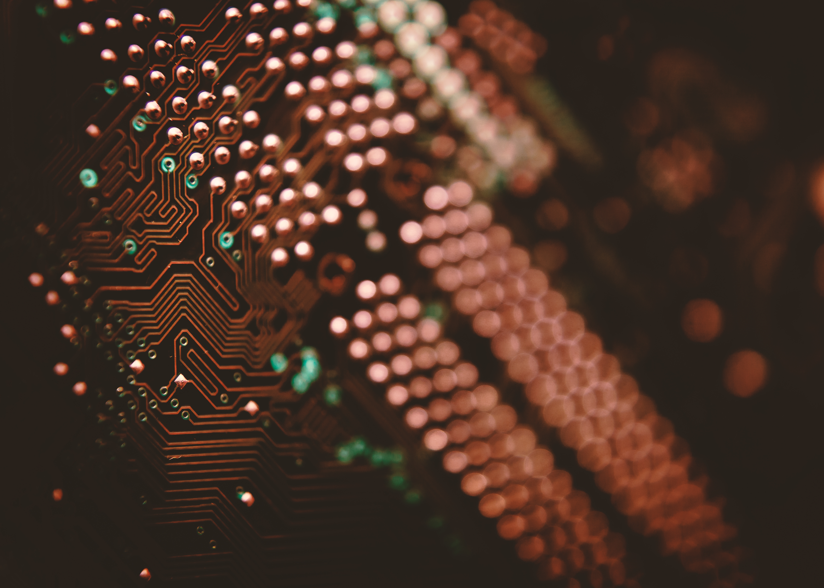




Introduction
Existing system with limitations
Proposed system with advantages
Modules
Technology used
Literature Survey
Future Scope
References

Slide 4
Introduction
Computer’s play a huge part in our daily lives, initially, their task was to solve mathematical problems and word processing now they have travelled a long way to make a necessary space in our lives with its uses ranging from professional to personal. Computers are readily usable to persons who have hands to control mouse and keyboard and eyes to see what is on the monitor. With the passing of time now even blind can use the computer using the text to speech option which pronounces the content on the screen.

Slide 5
But people who do not have hands cannot use it due to their inability to control mouse and keyboard operations. By introducing them to technology and make them computer compatible will create a ray of hope for them to learn and do some livelihood
This project doesn’t use any expensive equipment. Also, even physical connection has to be made with the user through any equipment.
It just need a computer with a webcam making it easy and cheap and uncomplicated method.
By taking real-time images of the user the program is designed to evaluate these images and identify the type of action to be performed and take parameter if needed in case of moving the cursor change in the relative position of eyes concerning the central position talk about the direction to move the cursor

Slide 6
Existing System With Limitations
With the advancement in time the computers have been updating now even blind can use the computer using the text to speech option which pronounce the content on the screen. But people who do not have hands cannot use it due to their inability to control mouse and keyboard operations. In today’s competitive environment everybody needs to be equipped with different set of skills so as to get a job knowledge and usage of computer being a necessity nowadays.
So this caused them to live a miserable life they have to beg and do pitiful activities to keep their lives going. By introducing them to a technology and making them computer compatible will create a ray of hope for them to learn and do some work for their livelihood

Slide 7
Existing System Disadvantages
It can only handle blinks and is not able to handle short blinks.
It effects eyes of users and causes problems in vision for them.
Short blinks is simply avoids

Slide 8
Proposed System
The camera keeps looking for pictures at the rate of 30 frames per second. if it can detect a face then it checks whether the face control function is on or off.
Then if it is enabled it captures frames for different instructions by the user through the movement of his face as per the directions given
If he wants to turn the scroll mode ON he/she has to squint both eyes and then move his face up or down for score scrolling
To simply move the cursor user will simply move his head
For click, he will squint one of his eyes as per the side of the mouse he wants to press

Slide 9
Proposed system advantages
Hands free computing
Eyes based human computer interaction provide real time eye tracking and eye gaze estimation
User can control mouse events like left click, right click, and double click etc. by movement of eyes
Stimulate mouse functions

Slide 10
List of Modules
Face Detection
Eye Detection
Mouth Detection

Slide 11
Literature Survey -01
Title: Real-Time driver drowsiness detection system using eye aspect ration and eye closure ratio
Author: sukrit mehta,
Year: 2019
Description: Every year many people lose their life due to fatal road accidents around the world and drowsy driving is one of the primary causes of rad accidents and death. So the traditional methods to detect drowsiness are based on behavioral aspect while some uses expensive sensors. In this paper a light-weight and real time drivers drowsiness detection system is developed and implemented on android application, where the system records the videos and detects the drivers face in every frame by employing image processing technique.

Slide 12
Survey-02
Title: Human computer interaction based eye controlled mouse
Vinay S Vasisht; Swaroop Joshi.
Year: 2019
Description: With advanced technologies in this digital era, there is always scope for development in the field of computing. Hands free computing is in demand as of today it addresses the needs of quadriplegics. This paper presents a Human computer interaction (HCI) system that is of great importance to amputees and those who have issues with using their hands. The system built is an eye based interface that acts as a computer mouse to translate eye movements such as blinking, gazing and squinting towards the mouse cursor actions.

Slide 13
Implementation:-
USER INTERFACE
RECORDING VIDEOS AND CONVERT IT IN FRAMES
EYE DETECTION AND TRACKING
STOP
BASIC OPERATIONS

Slide 14
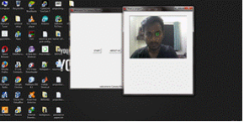
VIDEO STREAMING

Slide 15
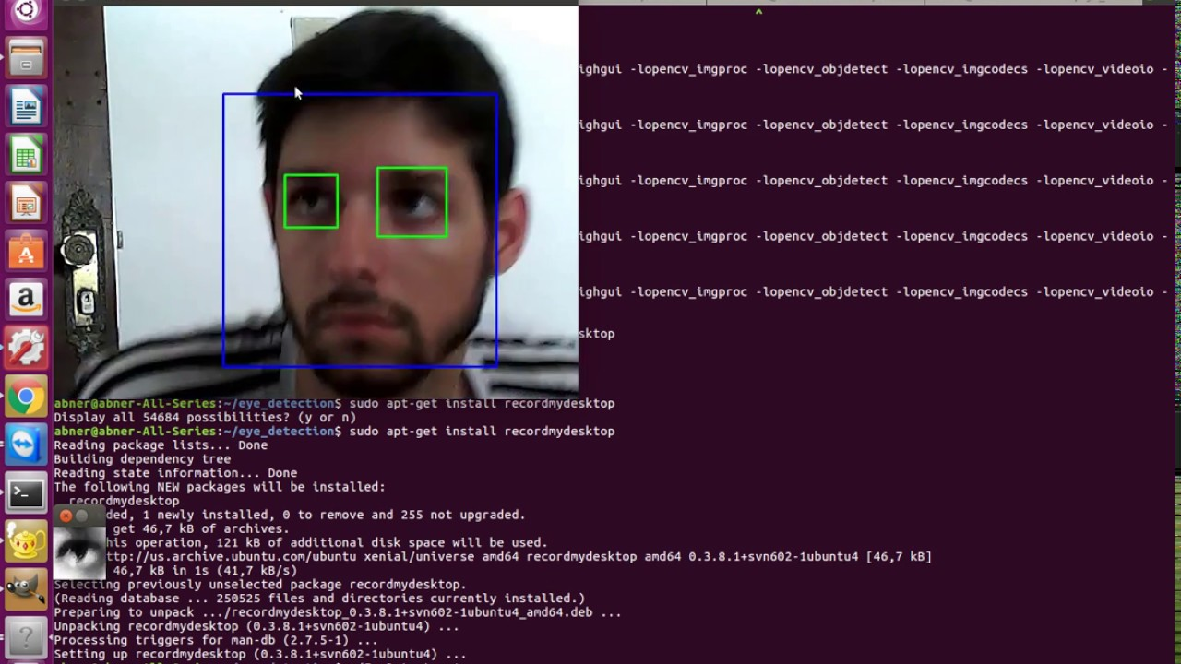
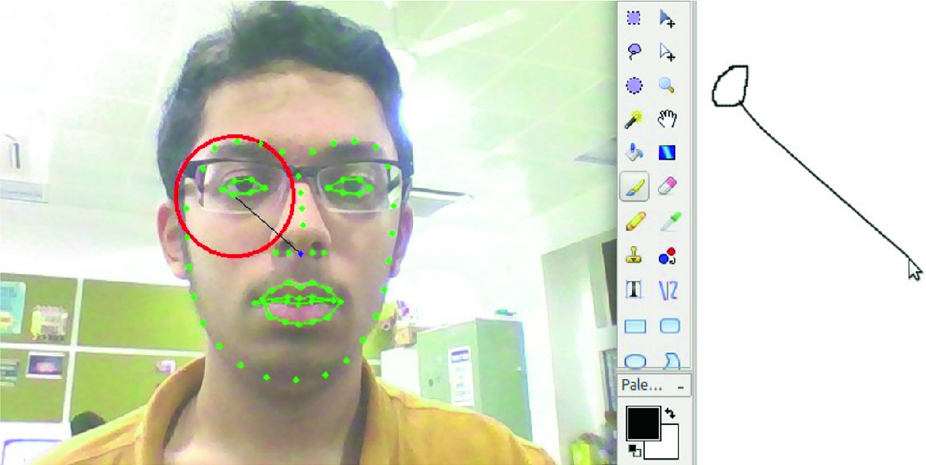
OUTPUT SCREENSHORT

Slide 16
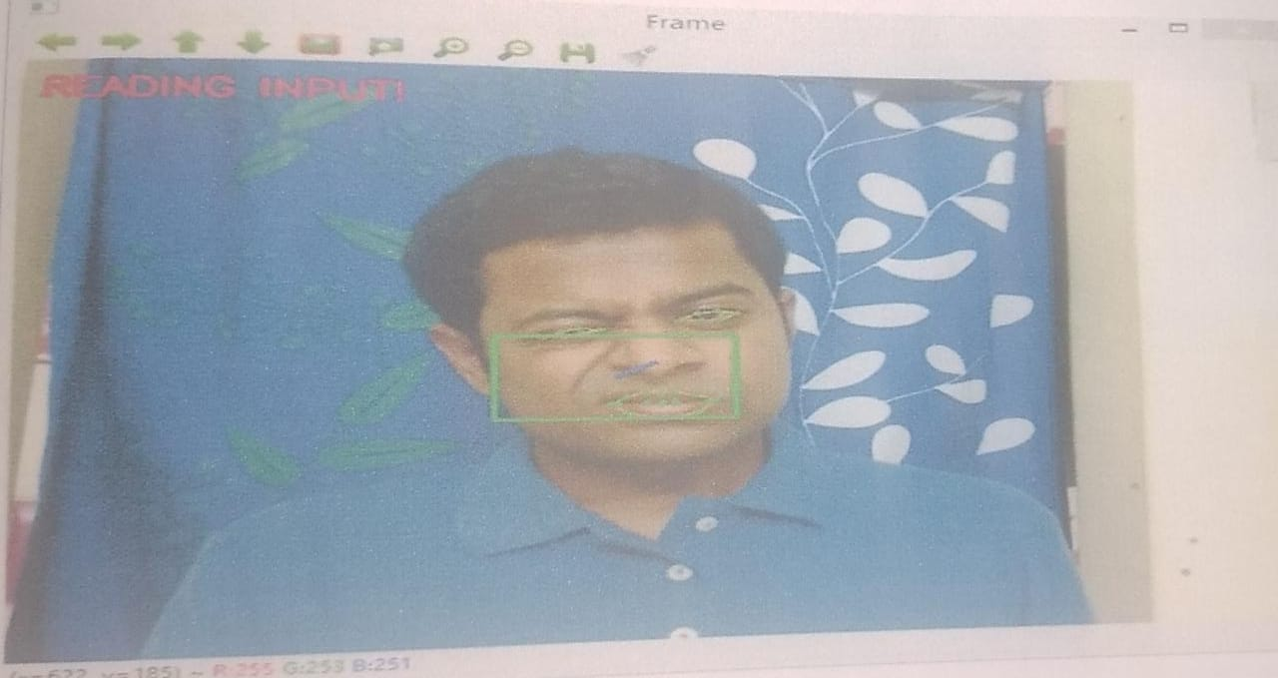
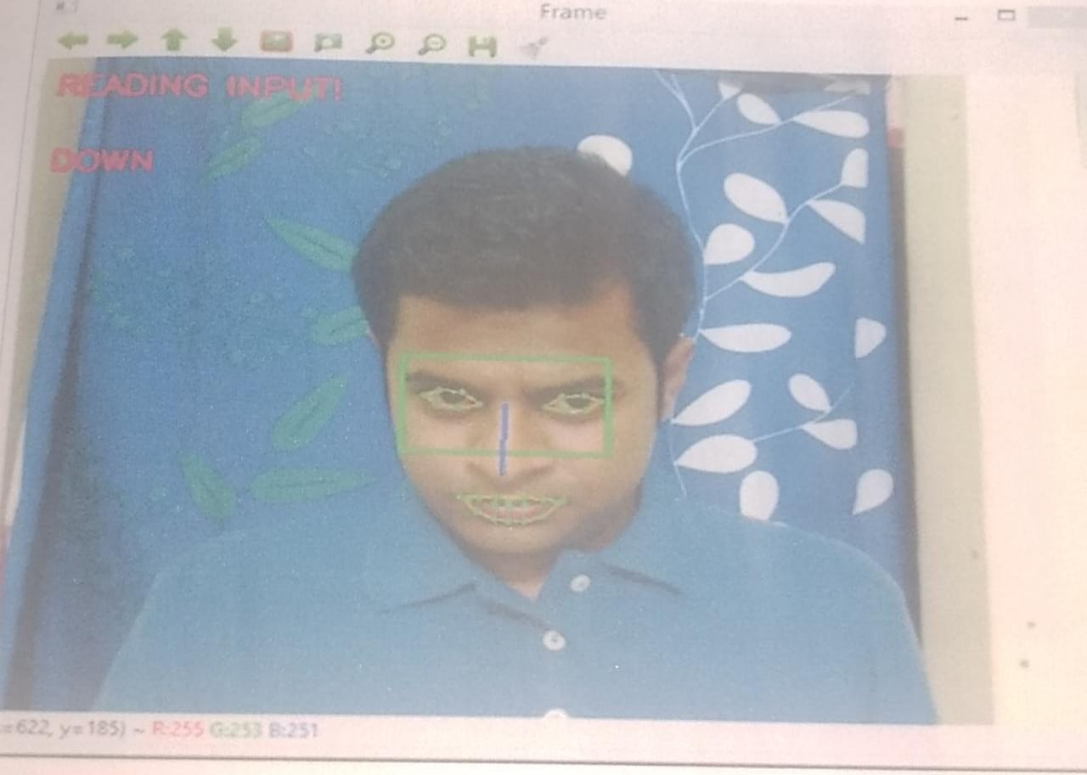
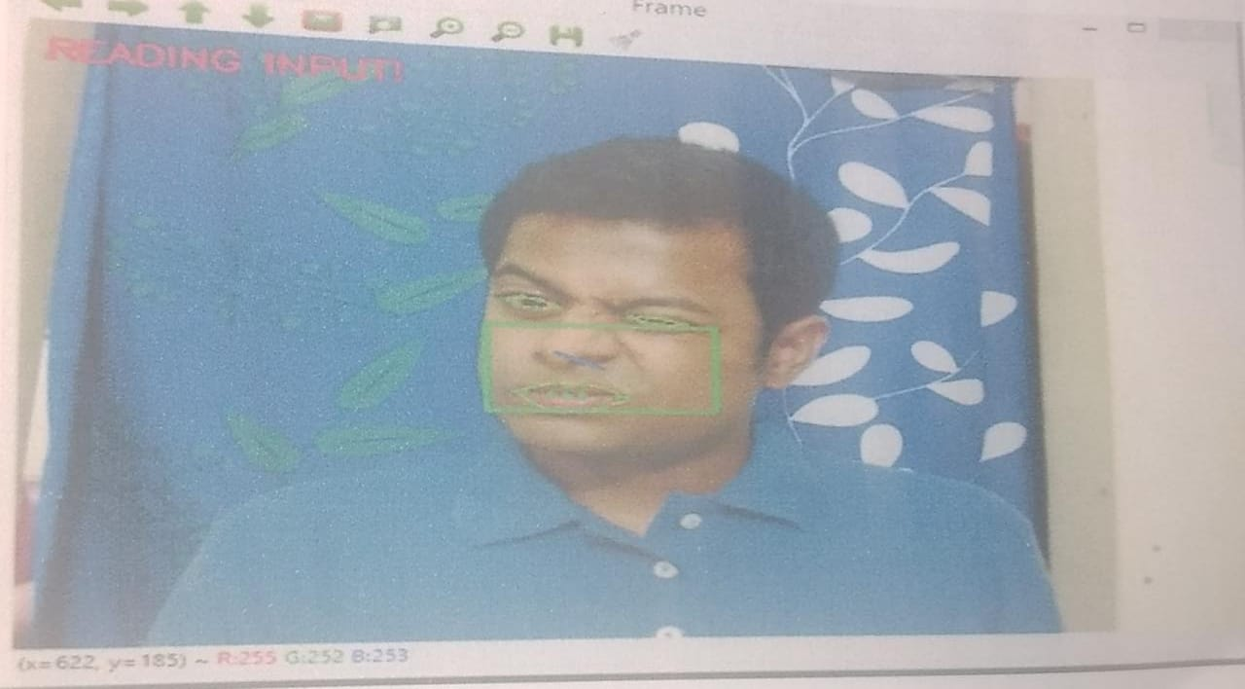
FACIAL DETECTION
RIGHT CLICK
SCROLLING DOWN
LEFT CLICK

Slide 17
Further Scope
From the process implemented it is cleared that the cursor can be controlled by the eyeball movement i.e., without using hands on the computers. This will be helpful for the people having disability in using the physical parts of the computers to control the cursor points. Because the cursor points can be operated by moving the eyeballs. Without the help of others disabled people can use the computers. This technology can be enhanced in the future by inventing more techniques like clicking events as well as to do all the mouse movements and also for human interface systems using eye blinks. Technology also extended to the eyeball movement and eye blinking to get the efficient and accurate movement.

Slide 18
References
[1] ShrunkhalaSatish Wankhede, Ms. S. A. Chhabria, Dr. R. V. Dharaskar, “Controlling Mouse Cursor Using Eye Movement” International Journal of Application or Innovation in Engineering & Management (IJAIEM), 2013
[2] Ramesh R and Rishikesh M; “Eye Ball Movement to Control Computer Screen”.
[3] Sanjay Gantyala, William Godad,NeelamPhadnis;” Controlling Mouse Events Using Eye Blink”; IJARCCE March 2016.
[4] PrajaktaTangade, ShitalMusale, GauriPasalkar, Miss. Umale M.D., Miss. Awate S.S., “A Review Paper on Mouse Pointer Movement Using Eye Tracking System and Voice Recognition.” International Journal of Emerging Engineering Research and Technology Volume 2, Issue 8, 2014.
[5] ArslanQamar Malik, and JehanzebAhmad , “Retina Based Mouse Control (RBMC)” International Journal of Electronics, Circuits and Systems Volume 1 Number 4, 2004.
[6] DhairyaVyas and Hardik N. Mewada, “Retina Based Mouse Control System” IJSRD - International Journal for Scientific Research & Development Vol. 1, Issue 11, 2014.
[7] Craig Hennessey, Jacob Fiset, “Long Range Eye Tracking: Bringing Eye Tracking into the Living Room”, IEEE, 2012.
[8] NAGESH R; “Eye Tracking Computer Control”; IRJET Nov2015.Figure 5.3: Opened FolderAfter detecting the eyes it will perform the basic operations. When user will stare on a particular icon it will open the file or folder.VI. CONCLUSION AND FUTURE SCOPEThe paper,controlling computer system using eye movements focuses on the development of hands free computing. The study of various movement –based human-compute

Slide 19
THANK YOU

